Slide 1
Informed Search
Md Mehrab Hossain Opi
CSE 4109: Artificial Intelligence

Slide 2
Informed Search
Informed Search algorithms use problem-specific knowledge (called a heuristic) to make better decision about which path to follow toward the goal.

Slide 3
Best-First Search
The general approach is called best-first search.
A node is selected for expansion based on an evaluation function, $f(n)$.
The node with the lowest evaluation is expanded first.
The choice of $f$ determines the search strategy.

Slide 4
Heuristic Function
Most best-first search algorithms include as a component of $f$ a heuristic function, denoted $h(n)$.
$$h\left(n\right)=estimated cost of the cheapest path from the state at a node n to a goal state.$$

Slide 5
Greedy Best-First Search
Greedy best-first search selects the node that appears to be closest to the goal, based on the heuristic function $h(n)$ only.
Let’s understand this with the maze problem.

Slide 6
Greedy Best First Search
Consider the following maze.
The agent wants to go to cell B from the cell A.
Our target is to find the shortest path.
 |  |  |  |  |  |  |  |  |  |  | B
A

Slide 7
Greedy Best First Search
Between C and D which point will lead us to B faster?
 |  |  |  |  |  |  |  |  |  |  | B
 |  |  |  |  |  |  | D
 | C
A

Slide 8
Greedy Best First Search
Let’s consider the Manhattan distance.
We will use this as the heuristic function.
$$h\left(C\right)=13$$
 |  |  |  |  |  |  |  |  |  |  | B
 |  |  |  |  |  |  | D
 | C
A
$h\left(D\right)=$6

Slide 9
Greedy Best First Search
Let’s find the $h(n)$ for all the cells.
11 |  | 9 |  | 7 |  |  |  | 3 | 2 |  | B
12 |  | 10 |  | 8 | 7 | 6 |  | 4 |  |  | 1
13 | 12 | 11 |  | 9 |  | 7 | 6 | 5 |  |  | 2
 | 13 |  |  | 10 |  | 8 |  | 6 |  |  | 3
 | 14 | 13 | 12 | 11 |  | 9 |  | 7 | 6 | 5 | 4
 |  |  | 13 |  |  | 10
A | 16 | 15 | 14 |  |  | 11 | 10 | 9 | 8 | 7 | 6

Slide 10
Greedy Best First Search
11 |  | 9 |  | 7 |  |  |  | 3 | 2 |  | B
12 |  | 10 |  | 8 | 7 | 6 |  | 4 |  |  | 1
13 | 12 | 11 |  | 9 |  | 7 | 6 | 5 |  |  | 2
 | 13 |  |  | 10 |  | 8 |  | 6 |  |  | 3
 | 14 | 13 | 12 | 11 |  | 9 |  | 7 | 6 | 5 | 4
 |  |  | 13 |  |  | 10
A | 16 | 15 | 14 |  |  | 11 | 10 | 9 | 8 | 7 | 6

Slide 11
Greedy Best First Search
Now, let’s apply the same algorithm on the following maze.
Is it the shortest path?
 | 10 | 9 | 8 | 7 | 6 | 5 | 4 | 3 | 2 | 1 | B
 | 11 |  |  |  |  |  |  |  |  |  | 1
 | 12 |  | 10 | 9 | 8 | 7 | 6 | 5 | 4 |  | 2
 | 13 |  | 11 |  |  |  |  |  | 5 |  | 3
 | 14 | 13 | 12 |  | 10 | 9 | 8 | 7 | 6 |  | 4
 |  |  | 13 |  | 11 |  |  |  |  |  | 5
A | 16 | 15 | 14 |  | 12 | 11 | 10 | 9 | 8 | 7 | 6
Cost = 33

Slide 12
Greedy Best First Search
 | 10 | 9 | 8 | 7 | 6 | 5 | 4 | 3 | 2 | 1 | B
 | 11 |  |  |  |  |  |  |  |  |  | 1
 | 12 |  | 10 | 9 | 8 | 7 | 6 | 5 | 4 |  | 2
 | 13 |  | 11 |  |  |  |  |  | 5 |  | 3
 | 14 | 13 | 12 |  | 10 | 9 | 8 | 7 | 6 |  | 4
 |  |  | 13 |  | 11 |  |  |  |  |  | 5
A | 16 | 15 | 14 |  | 12 | 11 | 10 | 9 | 8 | 7 | 6
Cost = 21

Slide 13
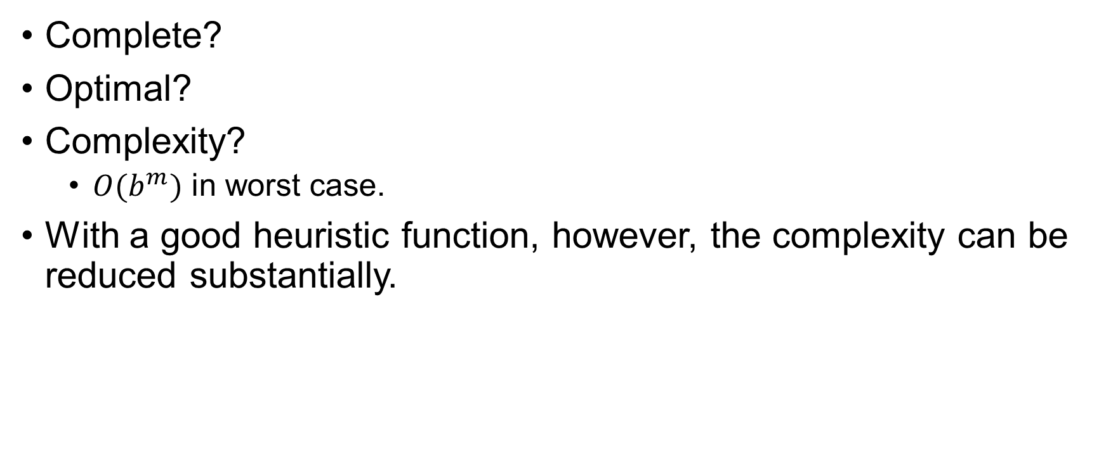
Greedy Best First Search
Complete?
Optimal?
Complexity?
$O(b^{m})$ in worst case.
With a good heuristic function, however, the complexity can be reduced substantially.

Slide 14
A*-Search
Most widely known form of best-first search.
It evaluates nodes by combining $g(n)$, the cost to reach the node, and $h(n)$, the cost to get from the node to the goal: $f\left(n\right)=h\left(n\right)+g\left(n\right)$
Since $g(n)$ gives the path cost from the start node to node $n$, and $h(n)$ is the estimated cost of the cheapest path from the node to the goal: $f\left(n\right)=estimated cost of the cheapest solution through n$

Slide 15
A*-Search
10+11
9+12
8+13
7+14
5+16
3+18
2+19
1+20
 | 10 | 9 | 8 | 7 | 6 | 5 | 4 | 3 | 2 | 1 | B
 | 11 |  |  |  |  |  |  |  |  |  | 1
 | 12 |  | 10 | 9 | 8 | 7 | 6 | 5 | 4 |  | 2
 | 13 |  | 11 |  |  |  |  |  | 5 |  | 3
 | 14 | 13 | 12 |  | 10 | 9 | 8 | 7 | 6 |  | 4
 |  |  | 13 |  | 11 |  |  |  |  |  | 5
A | 16 | 15 | 14 |  | 12 | 11 | 10 | 9 | 8 | 7 | 6
6+15
4+17
11+10
12+9
10+7
9+8
8+9
7+10
6+11
5+12
4+13
13+8
11+6
5+14
14+7
13+6
12+5
13+4
16+1
15+2
14+3

Slide 16
Greedy Best First Search/ A* Search
GreedyBestFirstSearch(problem):
node := create_node(problem.initial_state,
parent =null, action = null, path_cost = 0)
frontier := PriorityQueue ordered by h(n)
frontier.insert(node,f(node.state))
explored := empty set
while frontier is not empty:
node := frontier.pop()
if problem.is_goal(node.state):
return solution_path(node)
explored.add(node.state)
for each action in problem.actions(node.state):
child_state := problem.result(node.state,action)
step_cost := problem.step_cost(node.state, action,
child_state)
child_node := create_node(child_state,
parent=node, action = action,
path_cost = node.path_cost + step_cost)
if child_state not in explored and not in frontier:
f_value := f(child_state)
frontier.insert(child_node, f_value)
return failure

Slide 17
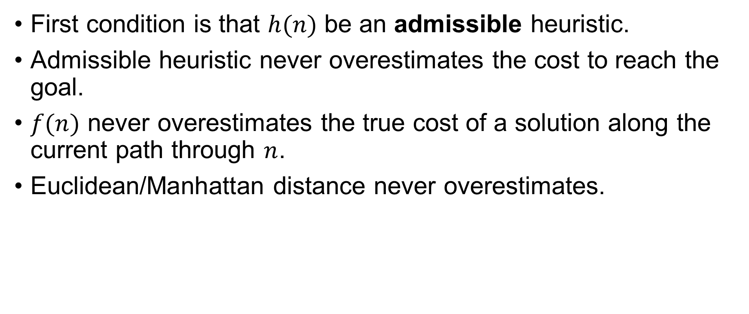
Condition of Optimality
First condition is that $h(n)$ be an admissible heuristic.
Admissible heuristic never overestimates the cost to reach the goal.
$f(n)$ never overestimates the true cost of a solution along the current path through $n$.
Euclidean/Manhattan distance never overestimates.

Slide 18
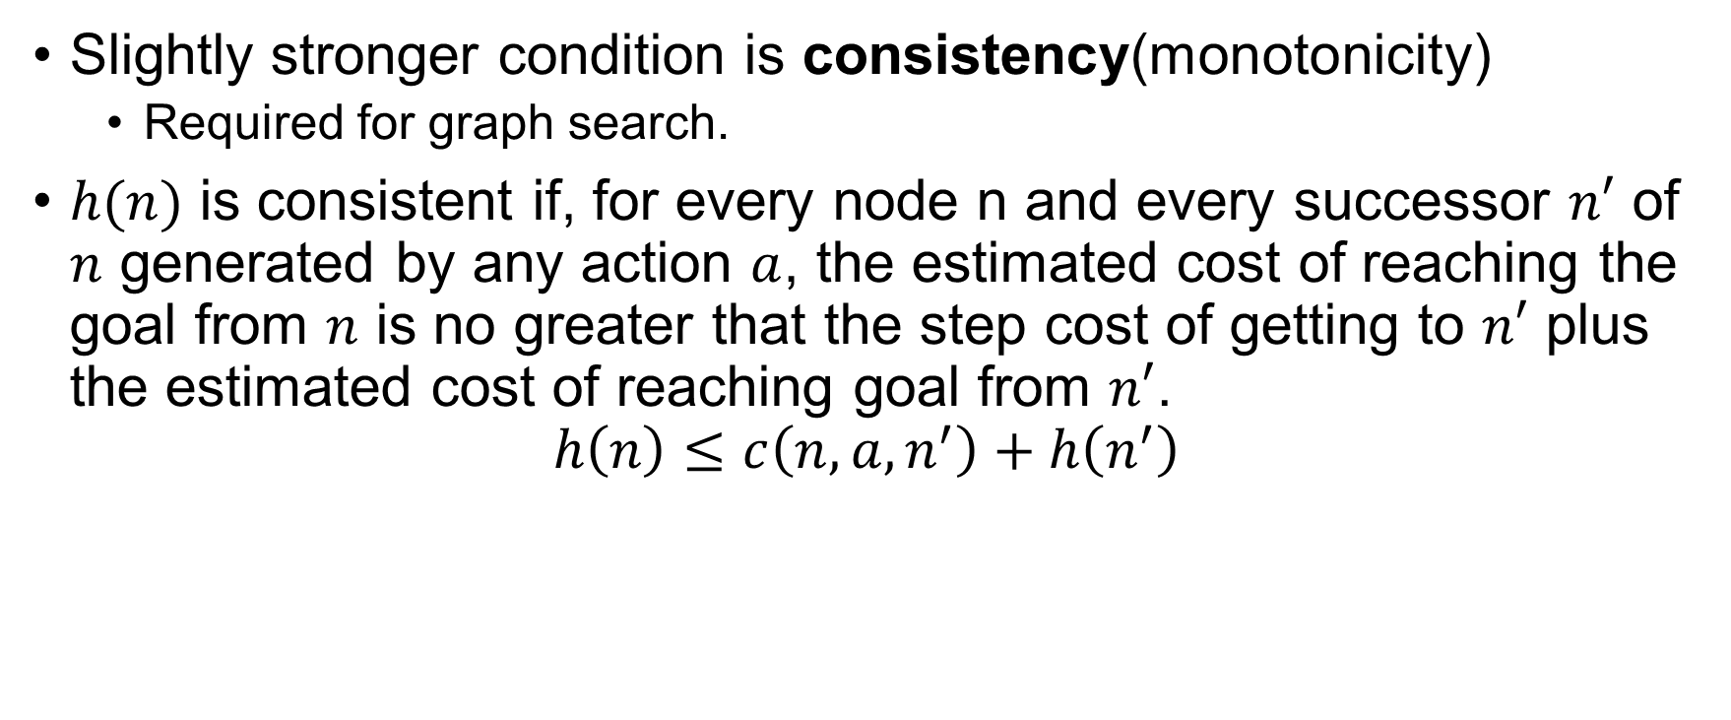
Condition of Optimality
Slightly stronger condition is consistency(monotonicity)
Required for graph search.
$h(n)$ is consistent if, for every node n and every successor $n′$ of $n$ generated by any action $a$, the estimated cost of reaching the goal from $n$ is no greater that the step cost of getting to $n′$ plus the estimated cost of reaching goal from $n′$.
$$h\left(n\right)≤c\left(n, a, n^{′}\right)+h\left(n^{′}\right)$$

Slide 19


Optimality of $A^{∗}$
The tree search is optimal if $h(n)$ is admissible.
The graph search is optimal if $h(n)$ is consistent.

Slide 20

Memory-bounded Heuristic Search
Simplest way to reduce memory is to use iterative deepening.
The algorithm is called iterative-deepening $A^{∗} ({IDA}^{∗})$.
The cut-off value is the $f−$cost ($g+h)$.

Slide 21
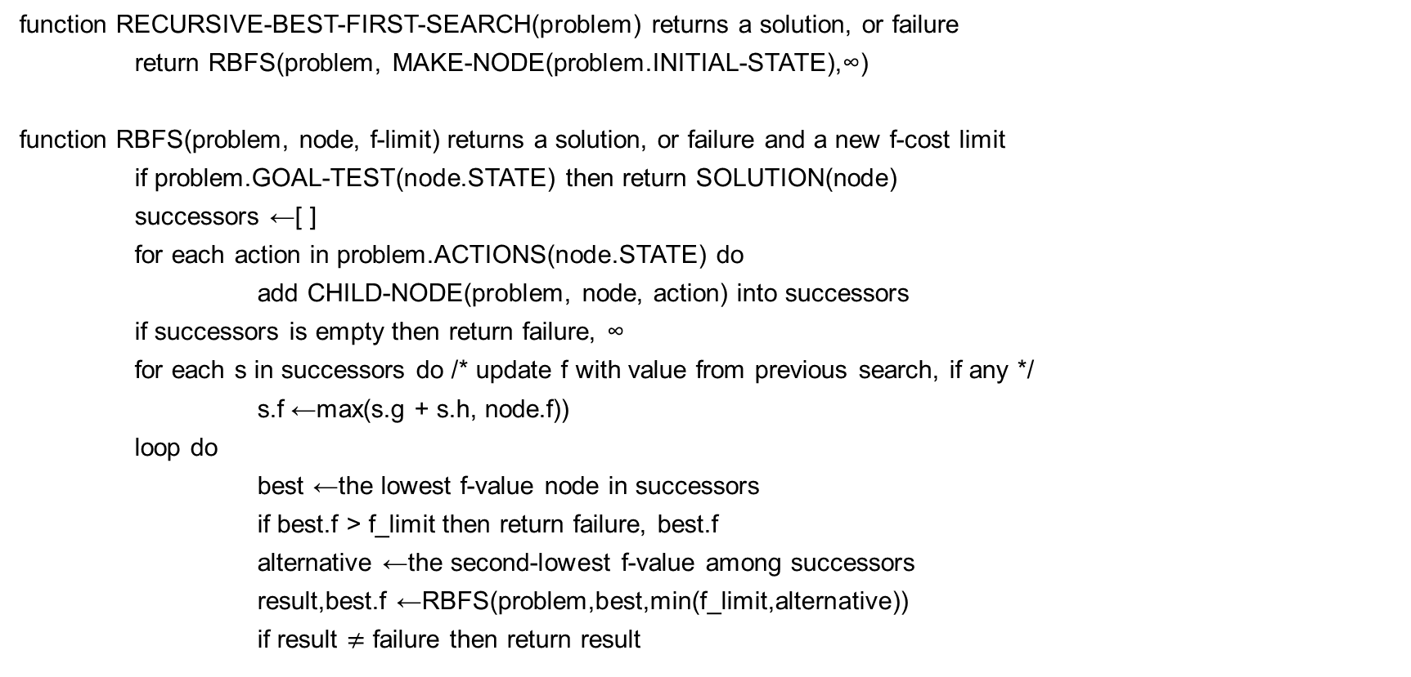
Recursive best-first Search
function RECURSIVE-BEST-FIRST-SEARCH(problem) returns a solution, or failure
return RBFS(problem, MAKE-NODE(problem.INITIAL-STATE),∞)
function RBFS(problem, node, f-limit) returns a solution, or failure and a new f-cost limit
if problem.GOAL-TEST(node.STATE) then return SOLUTION(node)
successors ←[ ]
for each action in problem.ACTIONS(node.STATE) do
add CHILD-NODE(problem, node, action) into successors
if successors is empty then return failure, ∞
for each s in successors do /* update f with value from previous search, if any */
s.f ←max(s.g + s.h, node.f))
loop do
best ←the lowest f-value node in successors
if best.f > f_limit then return failure, best.f
alternative ←the second-lowest f-value among successors
result,best.f ←RBFS(problem,best,min(f_limit,alternative))
if result $≠$ failure then return result

Slide 22
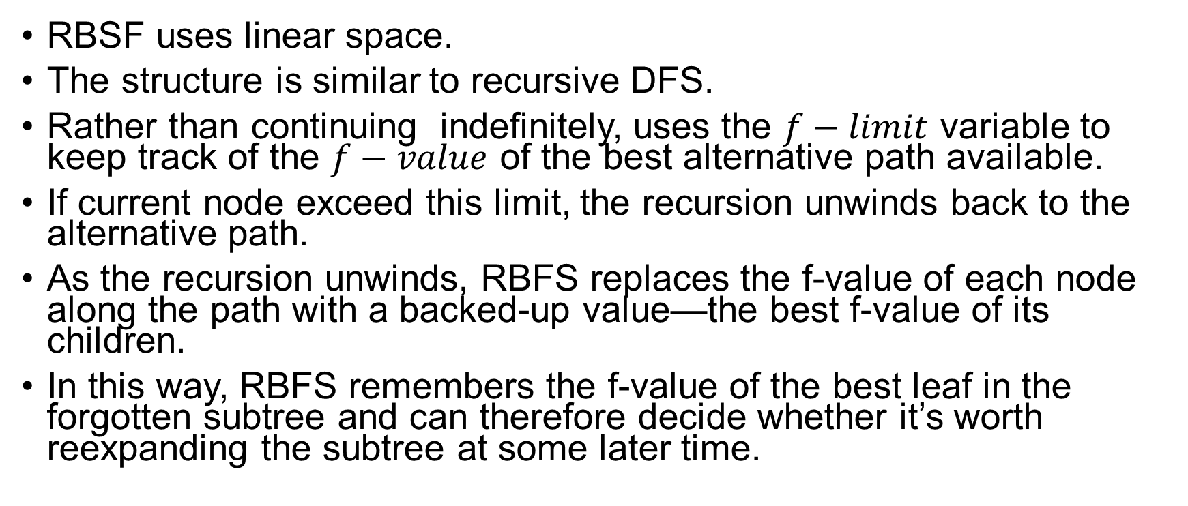
Recursive best-first Search
RBSF uses linear space.
The structure is similar to recursive DFS.
Rather than continuing indefinitely, uses the $f−limit$ variable to keep track of the $f−value$ of the best alternative path available.
If current node exceed this limit, the recursion unwinds back to the alternative path.
As the recursion unwinds, RBFS replaces the f-value of each node along the path with a backed-up value—the best f-value of its children.
In this way, RBFS remembers the f-value of the best leaf in the forgotten subtree and can therefore decide whether it’s worth reexpanding the subtree at some later time.

Slide 23
Thank You.

